Slide 1
CSC 112: Computer Operating Systems Lecture XX Concurrency & Synchronization
Department of Computer Science,
Hofstra University
Acknowledgement: Lecture slides based on UC Berkeley CS 162: Operating Systems and System Programming

Slide 2
Multithreaded Programs
Multithreaded programs must work for all interleavings of thread instruction sequences
Cooperating threads inherently non-deterministic and non-reproducible
Bugs can be really insidious:
Extremely unlikely that this would happen, but may strike at worse possible time
Really hard to debug unless carefully designed!

Slide 3
Atomic Operations
To understand a concurrent program, we need to know what the underlying indivisible operations are!
Atomic Operation: an operation that always runs to completion or not at all
It is indivisible: it cannot be stopped in the middle and state cannot be modified by someone else in the middle
Fundamental building block – if no atomic operations, then have no way for threads to work together
On most machines, memory references and assignments (i.e. loads and stores) of words are atomic
Many instructions are not atomic
Double-precision floating point store often not atomic
VAX and IBM 360 had an instruction to copy a whole array

Slide 4

Motivation: “Too much milk”
Consider two roommates who need to coordinate to get milk if out of milk:
This sequence of events results in too much milk:
Time
Person A
Person B
3:00
Look in Fridge. Out of milk
3:05
Leave for store
3:10
Arrive at store
Look in Fridge. Out of milk
3:15
Buy milk
Leave for store
3:20
Arrive home, put milk away
Arrive at store
3:25
Buy milk
3:30
Arrive home, put milk away
Notes:
You’re sitting in class, hot day, milk does a body good. Go home, no milk, so go to store
Roommate leaves class late because prof is more long-winded than I am. Has same idea, but result is too much milk!
Problem: two cooperating threads, not cooperating properly

Slide 5
Definitions
Synchronization: using atomic operations to coordinate multiple concurrent threads that are using shared state
Mutual Exclusion: ensuring that only one thread does a particular thing at a time
One thread excludes the other while doing its work
Critical Section: piece of code that only one thread can execute at once. Only one thread at a time will get into this section of code.
Critical section is the result of mutual exclusion
Critical section and mutual exclusion are two ways of describing the same thing.
Note: a thread A executing inside its critical section can be interrupted (preempted) by another thread B, as long as thread B is not in its critical section protected by the same lock.
Notes:
For now, only loads and stores are atomic
We are going to show that its hard to build anything useful with only reads and writes
ensure cooperation between threads
Synchronization is a way of

Slide 6
More Definitions
Lock: prevents someone from doing something
Lock before entering critical section and before accessing shared data
Unlock when leaving, after accessing shared data
Wait if locked
Important idea: all synchronization involves waiting
For example: fix the milk problem by putting a lock on the refrigerator
Lock it and take key if you are going to go buy milk
Too coarse-grained: the whole content in the refrigerator is unavailable
Roommate gets angry if he only wants OJ
Accesses to non-conflicting variables should not be delayed
Notes:
Of Course – We don’t know how to make a lock yet

Slide 7
Too Much Milk: Correctness Properties
Concurrent programs are non-deterministic due to many possible interleavings of program execution steps
Correctness properties for the “Too much milk” problem
Never more than one person buys
Someone buys if needed
Restrict ourselves to use only atomic load (read) and store (write) operations as building blocks

Slide 8

Too Much Milk: Solution #1
Use a note to avoid buying too much milk:
Leave a note before buying (kind of “lock”)
Remove note after buying (kind of “unlock”)
Don’t buy if note (wait)
Suppose a computer tries this (remember, only memory read/write are atomic):
if (noMilk) { if (noNote) { leave Note; buy milk; remove note; } }
Result?
Still too much milk but only occasionally!
Each thread can get context switched after checking milk and note but before buying milk!
Context-switch point
Notes:
Must work despite what the dispatcher does!
Really insidious:
Extremely unlikely that this would happen, but will at worse possible time

Slide 9
Too Much Milk: Solution #1½
Another try at previous solution:
leave Note;
if (noMilk) { if (noNote) { leave Note; buy milk; } }
remove note;
What happens here?
The code “leave Note; buy milk;” will never be executed.
No one ever buys milk!
Notes:
Clearly the Note is not quite blocking enough
Let’s try to fix this by placing note first
Well, with human, probably nothing bad
With computer:

Slide 10
To Much Milk Solution #2
How about labeled notes?
Now we can leave note before checking
Algorithm looks like this:
Thread A Thread B
leave note A; leave note B; if (noNote B) { if (noNoteA) { if (noMilk) { if (noMilk) { buy Milk; buy Milk; } } } } remove note A; remove note B;
Does this work? Still no
Possible for neither thread to buy milk
Thread A leaves note A; Thread B leaves note B; each sees the other’s note, thinking “I’m not getting milk, You’re getting milk”
Context switches at exactly the wrong times can lead each to think that the other is going to buy
Context-switch point
Context-switch point
Notes:
Probably something like this in UNIX

Slide 11
Too Much Milk Solution #3
Here is a possible two-note solution:
Thread A Thread B
leave note A; leave note B; while (note B) { //X if (noNote A) { //Y do nothing; if (noMilk) { } buy milk; if (noMilk) { } buy milk; } } remove note B; remove note A;
Does this work? Yes. It can guarantee that:
It is safe to buy, or
Other will buy, ok to quit
At X:
if no note B, safe for A to buy,
otherwise wait to find out what will happen
At Y:
if no note A, safe for B to buy
Otherwise, A is either buying or waiting for B to quit
Notes:
A while loop: As long as note B is up, wait
B:

Slide 12
Solution 3.5
Note that the solution is asymmetric!
Quzz: does it work if Thread B also has a symmetric while loop?
Thread A Thread B
leave note A; leave note B; while (note B) { while (note A) { do nothing; do nothing; } } if (noMilk) { if (noMilk) { buy milk; buy milk; } } remove note A; remove note B;
Context-switch point
Context-switch point
No. Each thread can leave a note, then go into infinite while loop.
Notes:
No. Each thread can leave a note, then go into infinite while loop.

Slide 13
Solution #3 Discussions
Solution #3 works, but it’s really unsatisfactory
Really complex – even for this simple an example
Hard to convince yourself that this really works
A’s code is different from B’s – what if lots of threads?
Code would have to be slightly different for each thread
While A is waiting, it is consuming CPU time
This is called “busy-waiting”
There’s a better way
Have hardware provide better (higher-level) primitives than atomic load and store
Build even higher-level programming abstractions on this new hardware support

Slide 14
Too Much Milk: Solution #4
We need to protect a single “Critical-Section” piece of code for each thread:
if (noMilk) { buy milk; }
Suppose we have some sort of implementation of a lock (more in a moment).
Lock.Acquire() – wait until lock is free, then grab
Lock.Release() – Unlock, waking up anyone waiting
These must be atomic operations – if two threads are waiting for the lock and both see it’s free, only one succeeds to grab the lock
Then, our milk solution is easy:
milklock.Acquire();
if (nomilk)
buy milk;
milklock.Release();
Notes:
Of course, you can make this even simpler: suppose you are out of ice cream instead of milk
Skip the test since you always need more ice cream.
Once again, section of code between Acquire() and Release() called a “Critical Section”

Slide 15
Where are we going with synchronization?
Programs
Shared Programs
Higher-level
API
Locks Semaphores Monitors Send/Receive
Hardware
Load/Store Disable Ints Test&Set Comp&Swap
We are going to implement various higher-level synchronization primitives using atomic operations
Everything is pretty painful if only atomic primitives are load and store
Need to provide primitives useful at user-level

Slide 16
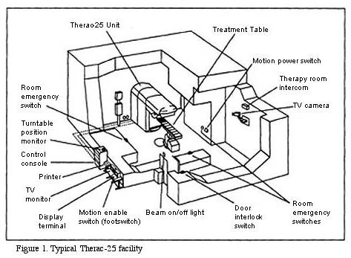
Therac-25 Example
Example: Therac-25
Machine for radiation therapy
Software control of electron accelerator and electron beam/ Xray production
Software control of dosage
Software errors caused the death of several patients
A series of race conditions on shared variables and poor software design
“They determined that data entry speed during editing was the key factor in producing the error condition: If the prescription data was edited at a fast pace, the overdose occurred.”

Slide 17
Space Shuttle Example
Original Space Shuttle launch aborted 20 minutes before scheduled launch
Shuttle has five computers:
Four run the “Primary Avionics Software System” (PASS)
Asynchronous and real-time
Runs all of the control systems
Results synchronized and compared every 3 to 4 ms
The Fifth computer is the “Backup Flight System” (BFS)
stays synchronized in case it is needed
Written by completely different team than PASS
Countdown aborted because BFS disagreed with PASS
A 1/67 chance that PASS was out of sync one cycle
Bug due to modifications in initialization code of PASS
Bug not found during extensive simulation
PASS
BFS
Notes:
A delayed init request placed into timer queue
As a result, timer queue not empty at expected time to force use of hardware clock

Slide 18
Summary
Concurrent threads are a very useful abstraction
Allow transparent overlapping of computation and I/O
Allow use of parallel processing when available
Concurrent threads introduce problems when accessing shared data
Programs must be insensitive to arbitrary interleavings
Without careful design, shared variables can become completely inconsistent
Important concept: Atomic Operations
An operation that runs to completion or not at all
These are the primitives on which to construct various synchronization primitives

Slide 19
High-Level Picture
Implementing a concurrent program with only loads and stores would be tricky and error-prone
Consider “too much milk” example
Showed how to protect a critical section with only atomic load and store ⇒ pretty complex!
Today, we’ll implement higher-level operations on top of atomic operations provided by hardware
Develop a “synchronization toolbox”
Explore some common programming paradigms
Notes:
The abstraction of threads is good:
Maintains sequential execution model
Allows simple parallelism to overlap I/O and computation

Slide 20
How to implement Locks?
Lock: prevents someone from doing something
Lock before entering critical section and before accessing shared data
Unlock when leaving, after accessing shared data
Wait if locked
Important idea: all synchronization involves waiting
Atomic Load/Store: get solution like Milk #3
Looked at this last lecture
Pretty complex and error prone
Hardware Lock instruction
Is this a good idea?
Complexity?
Done in the Intel 432
Each feature makes hardware more complex and slow
What about putting a task to sleep?
How do you handle the interface between the hardware and scheduler?

Slide 21
Naïve use of Interrupt Enable/Disable
How can we build multi-instruction atomic operations?
OS dispatcher gets control in two ways.
Internal: Thread does something to relinquish the CPU
External: Interrupts cause dispatcher to take CPU
On a uniprocessor, can avoid context-switching by:
Avoiding internal events
Preventing external events by disabling interrupts
Consequently, naïve Implementation of locks:
LockAcquire { disable Ints; }
LockRelease { enable Ints; }
Problems with this approach:
Can’t let user do this! Consider following:
LockAcquire(); While(TRUE) {;}
Real-Time system—no guarantees on timing!
Critical Sections might be arbitrarily long
What happens with I/O or other important events?
Notes:
(although virtual memory tricky)

Slide 22
Better Implementation of Locks by Disabling Interrupts
Key idea: maintain a lock variable and impose mutual exclusion only during operations on that variable
The waiting thread goes to sleep, instead of busy-waits. Sometimes called a “sleeping lock”, as compared to a “spinning lock”.
int value = FREE;
Acquire() { disable interrupts; if (value == BUSY) { put thread on wait queue; Go to sleep(); // Enable interrupts? } else { value = BUSY; } enable interrupts; }
Release() { disable interrupts; if (anyone on wait queue) { take thread off wait queue Place on ready queue; } else { value = FREE; } enable interrupts; }

Slide 23
New Lock Implementation: Discussion
Why do we need to disable interrupts?
Avoid interruption between checking and setting lock value
Otherwise two threads could think that they both have lock
Note: unlike previous solution, the critical section (inside Acquire()) is very short
Acquire() { disable interrupts; if (value == BUSY) { put thread on wait queue; Go to sleep(); // Enable interrupts? } else { value = BUSY; } enable interrupts; }
Critical
Section

Slide 24
Interrupt re-enable in going to sleep
What about re-enabling ints when going to sleep?
Before Putting thread on the wait queue?
Release can check the queue and not wake up thread
After putting the thread on the wait queue
Release puts the thread on the ready queue, but the thread still thinks it needs to go to sleep
Misses wakeup and still holds lock (deadlock!)
Want to put it after sleep(). But – how?
Acquire() { disable interrupts; if (value == BUSY) { put thread on wait queue; Go to sleep(); } else { value = BUSY; } enable interrupts; }
Enable Position?
Enable Position?
Enable Position?

Slide 25
How to Re-enable After Sleep()?
In Nachos, since ints are disabled when you call sleep:
Responsibility of the next thread to re-enable ints
When the sleeping thread wakes up, returns to acquire and re-enables interrupts
Thread A Thread B
. . disable ints sleep
sleep return enable ints
. . .
disable int sleep
sleep return enable ints . .
context switch
context switch

Slide 26
Hardware Mechanism
Problem with previous solution:
Relies on programmer discipline for correctness
CPUs generally have hardware mechanisms to support this requirement.
For example, on the Atmega128 microcontroller, the sei instruction does not re-enable interrupts until two cycles after it is issued (so the instruction sequence sei sleep runs atomically).

Slide 27
Atomic Instruction Sequences
Problem with disabling interrupts
Can be dangerous: interrupts should not be disabled for a long time, otherwise may miss important interrupts
Doesn’t work well on multiprocessor
Disabling interrupts on all processors requires messages and would be very time consuming
Alternative: atomic read-modify-write instruction sequences supported by hardware
These instructions read a value from memory and write a new value atomically
Hardware is responsible for implementing this correctly on both uniprocessors (not too hard) and multiprocessors (requires help from cache coherence protocol)
Can be used on both uniprocessors and multiprocessors

Slide 28
Hardware-Supported Atomic Read-Modify-Write Instructions
test&set:set content of “address” to 1, and return its original content
test&set (&address) result = M[address]; M[address] = 1; return result; }
compare&swap:compare content of “address” to reg1; if same, set it to reg2
compare&swap (&address, reg1, reg2) { /* 68000 */ if (reg1 == M[address]) { M[address] = reg2; return success; } else { return failure; } }
Notes:
swap (&address, register) { /* x86 */ temp = M[address]; M[address] = register; register = temp; }
compare&swap (&address, reg1, reg2) { /* 68000 */ if (reg1 == M[address]) { M[address] = reg2; return success; } else { return failure; } }

Slide 29
Implementing Locks with test&set
A simple solution:
int value = 0; // Free
Acquire() { while (test&set(value)); // while busy }
Release() { value = 0; }
Explanation:
If lock is free, test&set reads 0 and sets value=1, so lock is now busy. It returns 0 so while exits.
If lock is busy, test&set reads 1 and sets value=1 (no change). It returns 1, so while loop continues
When we set value = 0, someone else can get lock
Busy-Waiting: thread consumes cycles while waiting

Slide 30
Problem: Busy-Waiting for Lock
Positives for this solution
Interrupts are not disabled
User code can use this lock
Works on a multiprocessor
Negatives
Inefficient, because the busy-waiting thread will consume cycles waiting idly
Waiting thread may take cycles away from thread holding lock
Priority Inversion: For priority-based scheduling, if busy-waiting thread has higher priority than thread holding lock ⇒ no progress!
Round-robin scheduling is OK

Slide 31
Higher-Level Primitives than Locks
Good primitives and practices important!
UNIX is pretty stable now, but up until about mid-80s (10 years after started), systems running UNIX would crash every week or so – concurrency bugs
Semaphores and Monitors next
Notes:
Goal of last couple of lectures:
What is the right abstraction for synchronizing threads that share memory?
Want as high a level primitive as possible

Slide 32
Semaphores
Semaphores are a kind of generalized “sleeping” lock
Main synchronization primitive used in original UNIX
Definition: a Semaphore has a non-negative integer value and supports the following two operations:
P(): an atomic operation that waits for semaphore to become positive, then decrements it by 1
Also called wait() or down()
V(): an atomic operation that increments the semaphore by 1, waking up a waiting P, if any
Also called signal() or up()
Note that P() stands for “proberen” (to test) and V stands for “verhogen” (to increment) in Dutch
Notes:
First defined by Dijkstra in late 60s

Slide 33
Semaphore Operation
s.P():
if s.value > 0
then decrement s.value
else calling thread goes to sleep(blocked on s in a FIFO queue)
Endif
s.V():
if exist threads blocked on s
then awake one of them
else increment s.value
endif

Slide 34
Semaphores Like Integers Except
Semaphores are like integers, except
No negative values
Only operations allowed are P and V – can’t read or write value, except to set it initially
A thread’s P and V operations must be atomic with regard to another thread’s P and V operations
Two P’s together can’t decrement value below zero
Similarly, thread going to sleep in P won’t miss wakeup from V – even if they both happen at same time
Semaphore from railway analogy
Here is a semaphore initialized to 2 for resource control:
Value=
2
1
0

Slide 35
Implementing Semaphores w/ test&set
test&set is still busy-waiting, but it only busy-waits to atomically check guard value (very short)
int guard = 0;
int value = 0;
P() {
// Short busy-wait time while (test&set(guard)); if (value == 0) {
put thread on wait queue;
go to sleep() & guard = 0; } else { value = value - 1; guard = 0; } }
V() { // Short busy-wait time while (test&set(guard)); if anyone on wait queue { take thread off wait queue Place on ready queue; } else { value = value + 1; } guard = 0;
}
Notes:
Note: sleep() and release the lock (set guard=0) must be atomic. Similar to the case on slide “Interrupt re-enable in going to sleep”. (can do this in software without hardware support).

Slide 36
Two Uses of Semaphores
Mutual Exclusion (initial value = 1)
A “binary semaphore” is called a “mutex”
Can be used for mutual exclusion:
semaphore.P(); // Critical section semaphore.V();
Scheduling Constraints (initial value = 0)
Locks are fine for mutual exclusion, but what if you want a thread to wait for something?
Example: suppose you had to implement ThreadJoin(): If T1 calls T2.ThreadJoin(), then T1 waits for T2 to terminate:
Initial value of semaphore = 0
ThreadJoin { semaphore.P(); }
ThreadFinish { semaphore.V(); }

Slide 37
Using Semaphores for Mutex
semaphore mutex = 1 -- unlocked
1 repeat
2 mutex.P();
3 critical section
4 mutex.V();
5 remainder section
6 until FALSE
1 repeat
2 mutex.P();
3 critical section
4 mutex.V();
5 remainder section
6 until FALSE
Thread A
Thread B

Slide 38
Using Semaphores for Mutex
semaphore mutex = 0 -- locked
1 repeat
2 mutex.P();
3 critical section
4 mutex.V();
5 remainder section
6 until FALSE
1 repeat
2 mutex.P();
3 critical section
4 mutex.V();
5 remainder section
6 until FALSE
Thread A
Thread B

Slide 39
Using Semaphores for Mutex
semaphore mutex = 0 --locked
1 repeat
2 mutex.P();
3 critical section
4 mutex.V();
5 remainder section
6 until FALSE
1 repeat
2 mutex.P();
3 critical section
4 mutex.V();
5 remainder section
6 until FALSE
Thread A
Thread B

Slide 40
Using Semaphores for Mutex
semaphore mutex = 0 -- locked
1 repeat
2 mutex.P();
3 critical section
4 mutex.V();
5 remainder section
6 until FALSE
1 repeat
2 mutex.P();
3 critical section
4 mutex.V();
5 remainder section
6 until FALSE
Thread A
Thread B

Slide 41
Using Semaphores for Mutex
semaphore mutex = 0 -- locked
1 repeat
2 mutex.P();
3 critical section
4 mutex.V();
5 remainder section
6 until FALSE
1 repeat
2 mutex.P();
3 critical section
4 mutex.V();
5 remainder section
6 until FALSE
Thread A
Thread B

Slide 42
Using Semaphores for Mutex
semaphore mutex = 1 -- unlocked
This thread can
now be released!
1 repeat
2 mutex.P();
3 critical section
4 mutex.V();
5 remainder section
6 until FALSE
1 repeat
2 mutex.P();
3 critical section
4 mutex.V();
5 remainder section
6 until FALSE
Thread A
Thread B

Slide 43
Using Semaphores for Mutex
semaphore mutex = 0 -- locked
1 repeat
2 mutex.P();
3 critical section
4 mutex.V();
5 remainder section
6 until FALSE
1 repeat
2 mutex.P();
3 critical section
4 mutex.V();
5 remainder section
6 until FALSE
Thread A
Thread B

Slide 44
Using Semaphores for Scheduling
Consider 5 threads or processes A, B, C, D, E. They must execute based on the partial ordering below, regardless of the ordering of process start (e.g., if process E starts before processes B and D finishes, it will be blocked waiting for B and D to finish before it can execute):
Process B
Process A
Process E
Process C
Process D

Slide 45
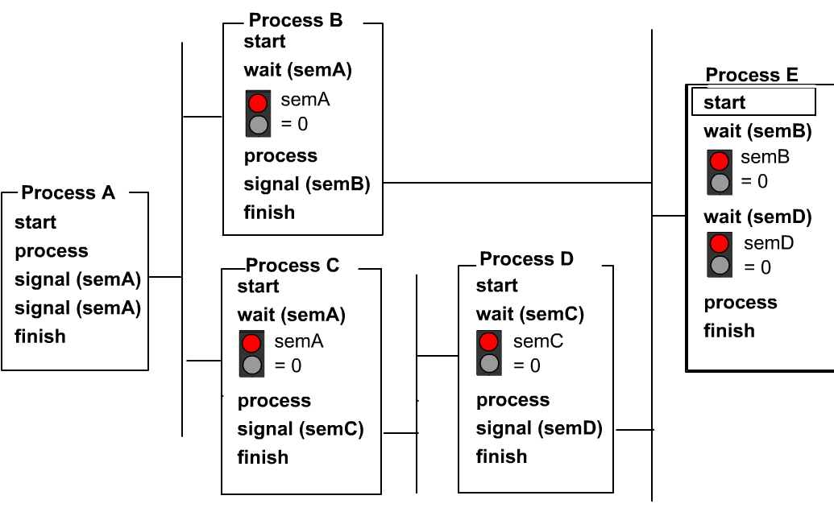
Solution
See animation
Note: syntax here is slightly different: wait(sem) and signal(sem) are used instead of sem.P() and sem.V().

Slide 46

Producer-consumer with a bounded buffer
Producer
Consumer
Buffer
Problem Definition
Producer puts things into a shared buffer
Consumer takes them out
Need synchronization to coordinate producer/consumer
Don’t want producer and consumer to have to work in lockstep, so put a fixed-size buffer between them
Need to synchronize access to this buffer
Producer needs to wait if buffer is full
Consumer needs to wait if buffer is empty
Example 1: GCC compiler
cpp | cc1 | cc2 | as | ld
Example 2: Coke machine
Producer can put limited number of cokes in machine
Consumer can’t take cokes out if machine is empty

Slide 47
Correctness Constraints for Solution
Correctness Constraints:
Consumer must wait for producer to fill buffers, if none full (scheduling constraint)
Producer must wait for consumer to empty buffers, if all full (scheduling constraint)
Only one thread can manipulate buffer queue at a time (mutual exclusion)
Remember why we need mutual exclusion
Because computers are stupid
Imagine if in real life: the delivery person is filling the machine and somebody comes up and tries to stick their money into the machine
General rule of thumb: Use a separate semaphore for each constraint
Semaphore fullBuffers; // consumer’s constraint
Semaphore emptyBuffers;// producer’s constraint
Semaphore mutex; // mutual exclusion

Slide 48
Solution to Bounded Buffer Problem with Semaphores
Semaphore fullBuffer = 0; // Initially, no coke
Semaphore emptyBuffers = numBuffers; // Initially, num empty slots
Semaphore mutex = 1; // No one using machine
Producer(item) { emptyBuffers.P(); // Wait until space mutex.P(); // Wait until buffer free Enqueue(item); mutex.V(); fullBuffers.V(); // Tell consumers there is // more coke }
Consumer() { fullBuffers.P(); // Check if there’s a coke mutex.P(); // Wait until machine free item = Dequeue(); mutex.V(); emptyBuffers.V(); // tell producer need more return item; }

Slide 49
Discussion about Solution
Why asymmetry?
Producer does:
emptyBuffer.P(), fullBuffer.V()
Consumer does:
fullBuffer.P(), emptyBuffer.V()
Is order of P’s important?
Yes! Can cause deadlock: thread holds mutex and goes to sleep
Is order of V’s important?
No, except that it might affect scheduling efficiency
What if we have 2 producers or 2 consumers?
Code still works!

Slide 50
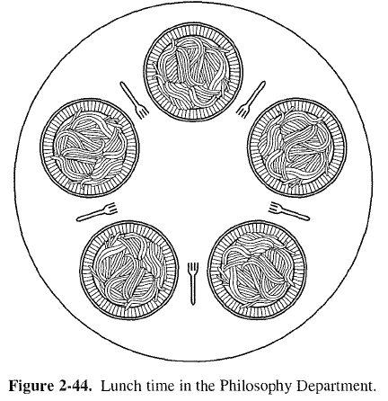
The dining philosophers
N philosophers sitting at a round table for a meal
Each has a plate of food
Each needs two forks to eat
There is one fork between each two plates
(analogous to resource sharing in a computer system)

Slide 51
Philosopher State Machine
3 states,(eating, thinking, hungry)
A philosopher thinks until he becomes hungry, moving from state thinking to state hungry
He may move from state hungry to state eating (begin to eat only) if both forks are available (their neighbors are not eating)
When he is finished eating, he starts to think again (move from state eating to state thinking)
eating
hungry
thinking

Slide 52
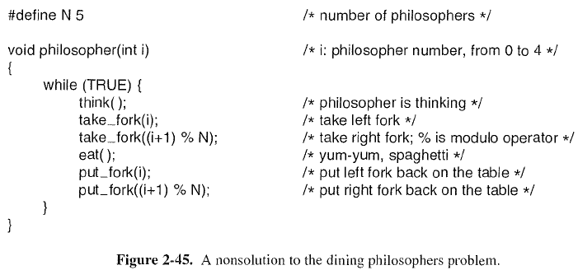
A Non-Solution
takeFork(i)/takeFork((i+1)%N) checks to see if the left/right fork is available, and blocks if it is not (can be implemented with one semaphore per fork);
if everyone grabs his left fork simultaneously, deadlock occurs.

Slide 53
Ordered Forks
Assign a total order to the resources, and establish the convention that all resources will be requested in the same order, and released in reverse order
Label forks from 1 to 5, and each philosopher must pick up lower-numbered fork before higher-numbered fork
4 philosophers pick up left fork before right fork, but 1 philosopher picks up right fork (1) before left fork (5).
Not always practical in practice:
Difficult to predict resource request order at runtime.

Slide 54
Another Try
After taking the left fork, a philosopher checks to see if the right fork is available. If it is not, he puts down the left one, waits for some time, and then repeats the whole process.
This proposal fails:
All philosophers could start the algorithm simultaneously, picking up their left forks, seeing that their right forks were not available, putting down their left forks, waiting, picking up their left forks again simultaneously, and so on, forever.
A situation like this, in which all the programs continue to run indefinitely but fail to make any progress is called starvation.
Notes:
If all philosophers think and eat with equal speed deadlock occurs
Try other approaches.
If one fork is blocked and the philosopher has the other, then put down the one that has already been picked up: can lead to starvation: everyone keeps on picking up and putting down forks without making progress
Try waiting a random length of time between picking up forks. Works most of the time, but particular conditions will still lead to deadlock or starvation

Slide 55
Randomized Solution?
If the philosophers would just wait a random time instead of the same time after failing to acquire the right-hand fork, the chance that everything would continue in lockstep for even an hour is very small. This observation is true, and in nearly all applications trying again later is not a problem.
For example, in the popular Ethernet local area network, if two computers send a packet at the same time, each one waits a random time and tries again; in practice this solution works fine.
However, one would prefer a solution that always works and cannot fail due to an unlikely series of random numbers.

Slide 56
Pessimistic Solution
If we use a global mutex so that only one philosopher can pick up forks and eat at any one time, we can solve the problem
This is not an optimal solution, since only one philosopher can be eating at one time; it should be possible for two philosophers to eat at the same time (there are 5 forks)
void philosopher(int i ) {
While( TRUE ) {
think();
down(&mutex);
take_fork(i)
take_fork((i+1)%N) eat( );
put_fork(i)
put_fork((i+1)%N) up(&mutex);
}

Slide 57
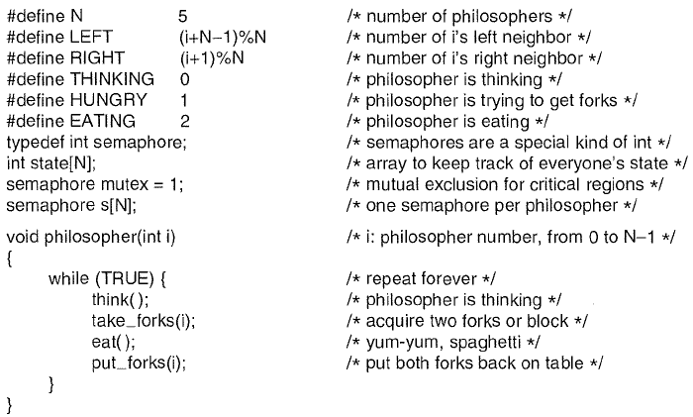
Solution
57

Slide 58
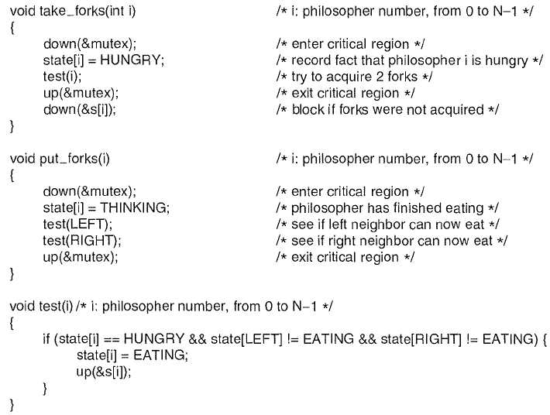
Solution Cont’
move the philosopher from the thinking state to the hungry state; Try to acquire forks; Block if either fork is not available OR Move the to the eating state if forks are acquired
Move the philosopher from the eating state to the thinking state; Consider each of the philosopher‘s neighbors in turn. If the neighbor is hungry and can now acquire both their forks, unblock the neighbor (this philosopher was the one blocking)
Test if left and right philosophers are not eating; if so, go from the hungry state to eating state, and up[&s[i]) s[i] so his later down(&s[i]) won’t block

Slide 59
Solution Discussions
Instead of one semaphore per fork, we have one semaphore per philosopher
Both neighbors are not eating → both forks are available
Before start eating → take both forks in an atomic operation; if unsuccessful, go to sleep
After finish eating → put down both forks in an atomic operation; tell both neighbors to check if each can start eating
Compare to the Pessimistic Solution: the time-consuming eat() is now outside of Critical Section to maximize concurrency

Slide 60
Solution Discussions Cont’
Q: Does this solution prevent starvation?
A: No. it’s possible for some philosophers to never get both forks.
Q: Can s[i] take value > 1?
A: No. The code ensures s[i] to be either 0 or 1, although it is not used as a mutex

Slide 61
Solution Discussions Cont’
Q: Can we remove semaphores s[i], and only use the mutex to guarantee atomicity of take_forks() and put_forks()?
A: This prevents deadlocks, but since it relies on the OS to choose the next thread to run, each philosopher may try and fail to take_forks() many times without making progress. (Similar problem with the “ordered forks” solution)
Semaphores s[i] enable more efficient execution by selectively waking up both neighbors when one is finished eating.
void philosopher(int i ) {
While( TRUE ) {
think();
if(both forks available){
down(&mutex);
take_fork(i)
take_fork((i+1)%N)
up(&mutex);
}
eat( );
down(&mutex);
put_fork(i)
put_fork((i+1)%N) up(&mutex);
}

Slide 62
Solution Discussions Cont’
Q: Can we remove mutex protection for the two put_fork() operations?
A: Yes.
void philosopher(int i ) {
While( TRUE ) {
think();
down(&mutex);
take_fork(i)
take_fork((i+1)%N)
up(&mutex);
eat( );
down(&mutex);
put_fork(i)
put_fork((i+1)%N) up(&mutex);
}

Slide 63
Solution Discussions Cont’
Q: Can we remove mutex protection for put_forks() in the original solution?
A: No. Need to protect test(i) and state[i]=THINKING to be atomic, since both are accessing shared vars state[i] (each philosopher can potentially change another philosopher’s state in test(i)).
Q: Can we protect each one separately, with 3 critical sections?
A: Yes. More fine-grained locking generally brings increased concurrency, potentially better performance on multiprocessor system
E.g., it allows thread to be interrupted in between test(LEFT) and test(RIGHT), hence some other philosopher may finish eating and put down more forks, to make test(RIGHT) more likely to succeed. (The reverse is also true: some other philosopher may pick up more forks. But at least it gives the system more possible execution sequences.)
Void put_forks(i)
{
down(&mutex);
state[i]=THINKING;
test(LEFT);
test(RIGHT);
up(&mutex);
}
Void put_forks(i)
{
down(&mutex);
state[i]=THINKING;
up(&mutex); down(&mutex);
test(LEFT);
up(&mutex); down(&mutex);
test(RIGHT);
up(&mutex);
}

Slide 64
Motivation for Monitors and Condition Variables
Semaphores are dual-purpose:
Used for both mutex and scheduling constraints, hence error-prone
Example: the fact that flipping of P’s in bounded buffer gives deadlock is not immediately obvious. How do you prove correctness to someone?
Monitors: use locks for mutual exclusion and condition variables for scheduling constraints
Definition: a monitor is a mutex lock and zero or more condition variables for managing concurrent access to shared data
Some languages like Java provide this natively
Notes:
Semaphores are an improvement; just think of trying to do the bounded buffer with only loads and stores

Slide 65
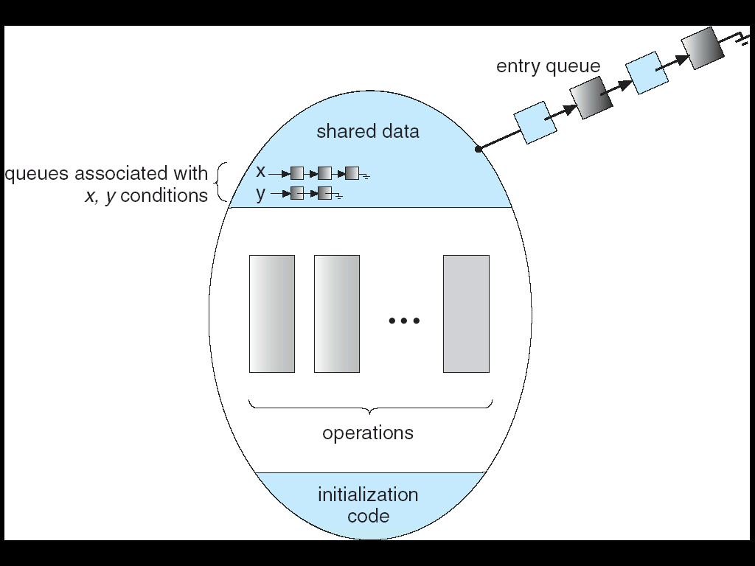
Monitor=mutex lock + condition variables
Mutex lock: the lock provides mutual exclusion to shared data
Always acquire before accessing shared data structure
Always release after finishing with shared data
Lock initially free
Condition Variable: keeps a queue of threads waiting for something inside a critical section
Makes it possible to go to sleep inside critical section by atomically releasing lock at time we go to sleep
Notes:
Contrast to semaphores: Can’t wait inside critical section
Condition Variable: keeps a queue of threads waiting for something inside a critical section
Key idea: allow sleeping inside critical section by atomically releasing lock at time we go to sleep

Slide 66
Monitor Semantics
Operations:
Wait(&lock): Atomically release mutex lock and go to sleep (Re-acquire lock later, before returning).
Signal(): Wake up a blocked (waiting) thread, if any (if no blocked thread, it’s a NO-OP)
The blocked thread is waken up inside its Wait(), tries to lock the mutex. When it (finally) succeeds, it returns from the Wait()
Broadcast(): Wake up all waiters
Notes:
Doesn’t this sound complex? Why do we do it?
the idea is that the “condition” of the condition variable depends on data protected by the mutex
Wait(&lock)unlocks the mutex lock and blocks the thread atomically
Signal()awakes a blocked (waiting) thread

Slide 67
Monitor Usage
Monitors represent the logic of the program
Wait if necessary
Signal when situation changes, so any waiting threads can proceed
Basic structure of monitor-based program (Rule: Must hold mutex lock when doing condition variable operations!)
lock.Acquire(); while (need to wait) { condvar.wait(&lock); } lock.Release(); do something
lock.Acquire();
condvar.signal();
lock.Release();
Check state variables;
Wait if necessary
Update
state variables

Slide 68
An Infinite Queue Implemented with Lock
Here is an (infinite) synchronized queue: RemoveFromQueue() may return null!
Lock lock; Queue queue;
AddToQueue(item) { lock.Acquire(); // Lock shared data queue.enqueue(item); // Add item lock.Release(); // Release Lock }
RemoveFromQueue() { lock.Acquire(); // Lock shared data item = queue.dequeue();// Get next item or null lock.Release(); // Release Lock return(item); // May return null! }

Slide 69
Condition Variables
How do we change the RemoveFromQueue() routine to wait until something is on the queue?
Could do this by keeping a count of the number of things on the queue (with semaphores), but error prone
Notes:
Contrast to semaphores: Can’t wait inside critical section

Slide 70
An Infinite Queue Implemented with Monitor
Here is an (infinite) synchronized queue
Easy to implemented a finite queue with 2 condition vars
Lock lock; Condition dataready; Queue queue;
AddToQueue(item) { lock.Acquire(); // Get Lock queue.enqueue(item); // Add item dataready.signal(); // Signal any waiters lock.Release(); // Release Lock }
RemoveFromQueue() { lock.Acquire(); // Get Lock while (queue.isEmpty()) { dataready.wait(&lock); // If nothing, sleep } item = queue.dequeue(); // Get next item lock.Release(); // Release Lock return(item); }
Why do we use
while instead of if?

Slide 71
Mesa vs. Hoare monitors
Need to be careful about precise definition of signal and wait.
Behavior depends on the type of monitor
Hoare-style:
Signaler gives up CPU to waiter, and waiter runs immediately
Can use if()
Mesa-style (most real OSes):
Signaler keeps running; waiter placed on ready queue with no special priority
Need to use while() loop to check queue.isEmpty()again after wait to make sure queue is still non-empty (not dequeued by some other thread) when waiter gets its turn to run
Notes:
Waiter gives up lock, processor back to signaler when it exits critical section or if it waits again
Consider a piece of our dequeue code:
while (queue.isEmpty()) { dataready.wait(&lock); // If nothing, sleep } item = queue.dequeue(); // Get next item
Why didn’t we do this?
if (queue.isEmpty()) { dataready.wait(&lock); // If nothing, sleep } item = queue.dequeue(); // Get next item

Slide 72
Readers/Writers Problem
W
R
R
R
Motivation: Consider a shared database
Two classes of users:
Readers – never modify database
Writers – read and modify database
Is using a single lock on the whole database sufficient?
Like to have many readers at the same time
Only one writer at a time
72

Slide 73
Basic Readers/Writers Solution
Correctness Constraints:
Readers can access database when no writers
Writers can access database when no readers or writers
Only one thread manipulates state variables at a time
Basic structure of a solution:
Reader() Wait until no writers Access data base Check out – wake up a waiting writer
Writer() Wait until no active readers or writers Access database Check out – wake up waiting readers or writer
State variables (Protected by a lock called “lock”):
int AR: Number of active readers; initially = 0
int WR: Number of waiting readers; initially = 0
int AW: Number of active writers; initially = 0
int WW: Number of waiting writers; initially = 0
Condition okToRead = NIL
Conditioin okToWrite = NIL
73

Slide 74
Code for a Reader
This gives writer preference: if WW>0, don’t let reader get in
Reader() { // First check self into system lock.Acquire();
while ((AW + WW) > 0) { // Is it safe to read? WR++; // No. Writers exist okToRead.wait(&lock); // Sleep on cond var WR--; // No longer waiting }
AR++; // Now we are active! lock.Release();
// Perform actual read-only access AccessDatabase(ReadOnly);
// Now, check out of system lock.Acquire(); AR--; // No longer active if (AR == 0 && WW > 0) // No other active readers okToWrite.signal(); // Wake up one writer lock.Release(); }
Why Release the Lock here?
To allow multiple readers to read
74
Notes:
To allow multiple readers to read. To allow multiple readers to read.

Slide 75
Code for a Writer
Writer() { // First check self into system lock.Acquire();
while ((AW + AR) > 0) { // Is it safe to write? WW++; // No. Active users exist okToWrite.wait(&lock); // Sleep on cond var WW--; // No longer waiting }
AW++; // Now we are active! lock.release();
// Perform actual read/write access AccessDatabase(ReadWrite);
// Now, check out of system lock.Acquire(); AW--; // No longer active if (WW > 0){ // Give priority to writers okToWrite.signal(); // Wake up one writer } else if (WR > 0) { // Otherwise, wake reader okToRead.broadcast(); // Wake all readers } lock.Release(); }
Why Release the Lock here?
Why Give priority to writers?
Why broadcast() here instead of signal()?
75
Notes:
Why release the lock: To allow readers/writers to wait in a queue
Why signal writer: only writer can get in anyway
Why broadcast reader: multiple readers can get in
Why give priority to writers? For efficiency. Even if we flip okToWrite.signal() and okToRead.signal(), writers still have priority due to while ((AW + WW) > 0) in reader. Readers would wake up and go back to sleep if there are any waiting writers

Slide 76
Answers
Why release the lock:
to allow readers/writers to wait in a queue
Why signal writer:
only writer can start writing
Why broadcast reader:
multiple readers can start reading
Why give priority to writers (okToWrite.signal() before okToRead.broadcast()) :
For efficiency reasons. Even if we flip okToWrite.signal() and okToRead.broadcast(), writers still have priority, due to the condition
while ((AW + WW) > 0)
in reader, which means a reader will wake up and go back to sleep if there are any waiting writers

Slide 77
Simulation of Readers/Writers solution
Consider the following sequence of operators:
R1, R2, W1, R3
On entry, each reader checks the following:
while ((AW + WW) > 0) { // Is it safe to read? WR++; // No. Writers exist okToRead.wait(&lock); // Sleep on cond var WR--; // No longer waiting }
AR++; // Now we are active!
First, R1 comes along: AR = 1, WR = 0, AW = 0, WW = 0
Next, R2 comes along: AR = 2, WR = 0, AW = 0, WW = 0
Now, readers make take a while to access database
Situation: Locks released
Only AR is non-zero
77

Slide 78
Simulation(2)
Next, W1 comes along: while ((AW + AR) > 0) { // Is it safe to write? WW++; // No. Active users exist okToWrite.wait(&lock); // Sleep on cond var WW--; // No longer waiting }
AW++;
Can’t start because of readers, so go to sleep:
AR = 2, WR = 0, AW = 0, WW = 1
Finally, R3 comes along: AR = 2, WR = 1, AW = 0, WW = 1
Now, say that R2 finishes before R1: AR = 1, WR = 1, AW = 0, WW = 1
Finally, last of first two readers (R1) finishes and wakes up writer:
if (AR == 0 && WW > 0) // No other active readers okToWrite.signal(); // Wake up one writer
78

Slide 79
Simulation(3)
When writer wakes up, get: AR = 0, WR = 1, AW = 1, WW = 0
Then, when writer finishes:
if (WW > 0){ // Give priority to writers okToWrite.signal(); // Wake up one writer } else if (WR > 0) { // Otherwise, wake reader okToRead.broadcast(); // Wake all readers }
Writer wakes up reader, so get:
AR = 1, WR = 0, AW = 0, WW = 0
When reader completes, we are finished
79

Slide 80
More Questions
Can readers starve? Consider Reader() entry code:
while ((AW + WW) > 0) { // Is it safe to read? WR++; // No. Writers exist okToRead.wait(&lock); // Sleep on cond var WR--; // No longer waiting }
AR++; // Now we are active!
Yes, since reader waits for waiting writers. But writers cannot starve, since writer doesn’t wait for waiting readers (while ((AW + AR) > 0)).
What if we erase the condition check in Reader exit?
AR--; // No longer active if (AR == 0 && WW > 0) // No other active readers okToWrite.signal(); // Wake up one writer
It’s ok. Since the writer is in a while loop.
80

Slide 81
Questions Cont’
Further, what if we turn the signal() into broadcast()
AR--; // No longer active okToWrite.broadcast(); // Wake up one writer
Only one writer can proceed anyway. The rest will go back to sleep, wakeup useless.
Finally, what if we use only one condition variable (call it “okToContinue”) instead of two separate ones, and noth readers and writers sleep on this variable
It works, but must use broadcast() instead of signal(), and may not be efficient,
e.g., awaken readers go back to sleep immediately if there are waiting writers
81

Slide 82
Can we construct Monitors from Semaphores?
Yes. Monitors are semaphores are equivalent in their expressiveness: any program written in one can be written with the other.
Locking aspect is easy: Just use a mutex
Can we implement condition variables this way?
Wait(Lock *lock) { semaphore.P(); }
Signal() {
semaphore.V(); }
Doesn’t work: Wait() sleeps with lock held
lock.Acquire(); while (need to wait) { condvar.wait(&lock); } lock.Release(); do something
lock.Acquire(); condvar.signal();
lock.Release();
Recall: Basic structure of monitor-based program
82
Notes:
lock while (need to wait) { condvar.wait(); } unlock do something so no need to wait
lock
condvar.signal();
unlock

Slide 83
Construction of Monitors from Semaphores (con’t)
Does this work better?
wait(Lock* lock) { lock->Release(); semaphore.P(); lock->Acquire(); } signal() { semaphore.V(); }
No!
1st problem: {lock.Release(); semaphore.P();} are not atomic
Another problem: Condition vars have no history, semaphores have history:
For condition vars:
What if thread signals and no one is waiting? NO-OP; signals are lost
What if thread later waits? Thread Waits
For semaphores
What if thread V’s and no one is waiting? Increment
What if thread later does P? Decrement and continue
83
Notes:
Waiter releases lock but did not go to sleep. Signaler gets the lock and does signal (V()). Waiter does P() and picks up the V(), so it doesn’t even sleep. It goes on to acquire the lock. Seems it will work?
(the syntax is loose. We assume a lock reference is passed, but should really be a lock pointer.)

Slide 84
Construction of Monitors from Semaphores (con’t)
The problem:
Semaphore P() and V() are commutative – result is the same no matter what order they occur
Condition variables are not commutative
Does this fix the problem?
Wait(Lock *lock) { lock->Release(); semaphore.P(); lock->Acquire(); } Signal() { if semaphore queue is not empty semaphore.V(); }
But illegal to look at contents of semaphore queue
It is actually possible to do this correctly
See http://www.cis.temple.edu/~ingargio/cis307/readings/monitor.html for a solution
84
Notes:
for Hoare scheduling in book
Can you come up with simpler Mesa-scheduled solution?

Slide 85
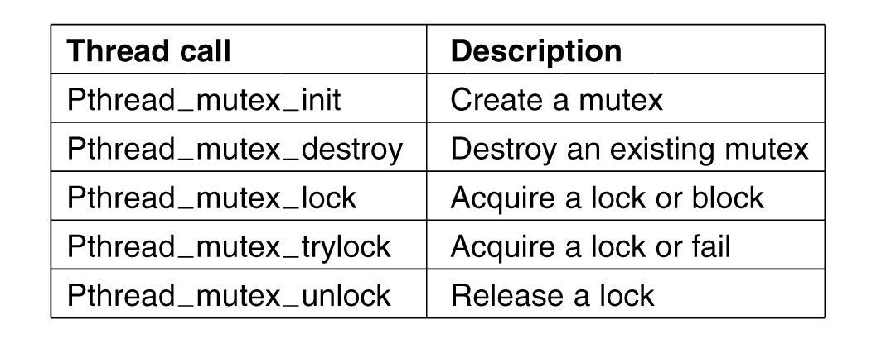
POSIX API for Mutex
Figure 2-30. Some of the Pthreads calls relating to mutexes.

Slide 86
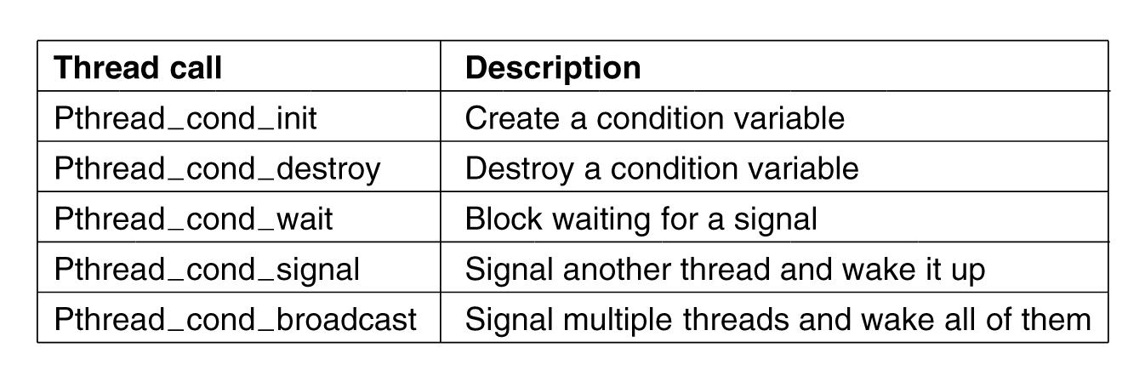
POSIX API for Condition
Figure 2-31. Some of the Pthreads calls relating to condition variables.

Slide 87
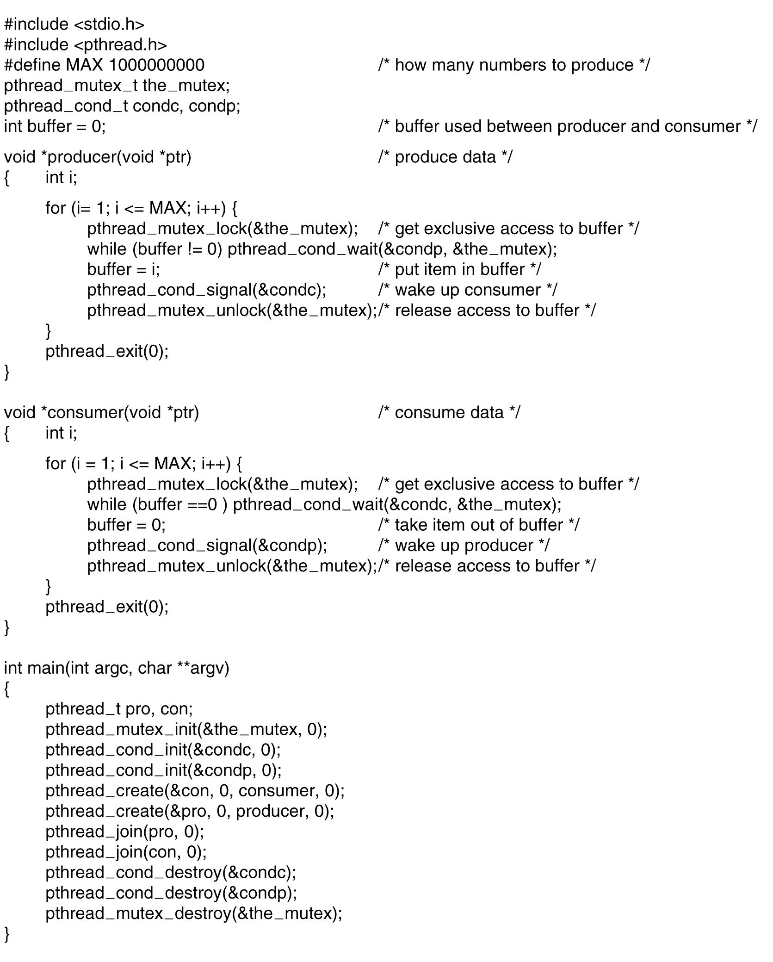
Solution to producer-consumer problem with POSIX mutex and condition

Slide 88
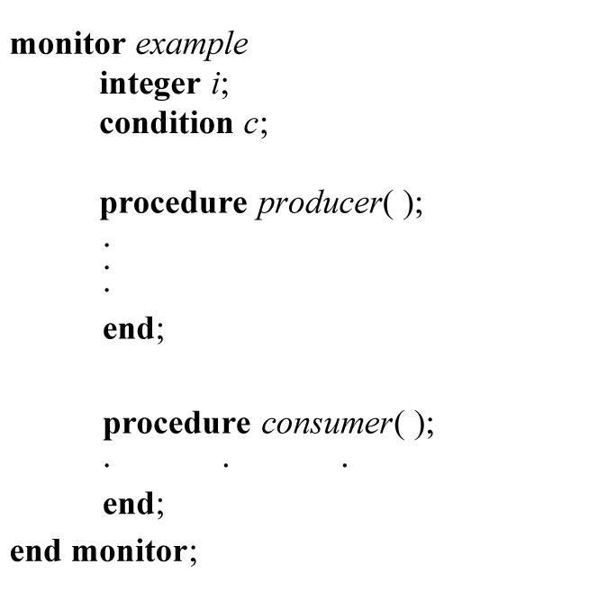
Monitor as a Language Construct
A monitor here is a collection of procedures, variables grouped inside a single class.
Threads can call the procedures inside the monitor, but cannot directly access its internal variables.
Only one thread can be running inside a monitor at any instant
Any procedure inside a monitor is a critical section.
Compiler automatically inserts locking, unlocking instructions for mutual exclusion, hence no explicit mutex in the monitor
Figure 2-33. A monitor.

Slide 89
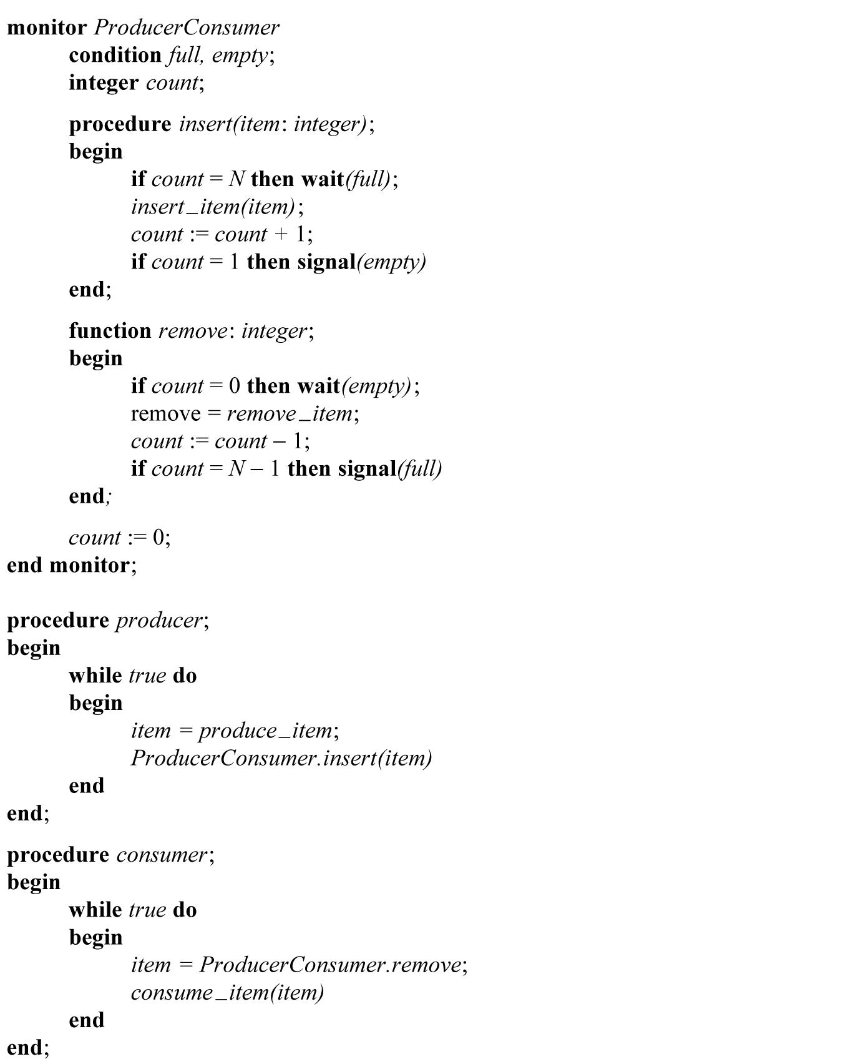
Producer-consumer solution using monitors
Similar to solution using semaphores
Most complexity is wrapped inside “Monitor ProducerConsumer”, while the procedures producer and consumer are very simple
Good software engineering practice:
Monitor can be provided as part of library API, so application programmer simply calls into the monitor without worrying about synchronization issues

Slide 90
Recall: Solution to Bounded Buffer Problem with Semaphores
Semaphore fullBuffer = 0; // Initially, no coke
Semaphore emptyBuffers = numBuffers; // Initially, num empty slots
Semaphore mutex = 1; // No one using machine
Producer(item) { emptyBuffers.P(); // Wait until space mutex.P(); // Wait until buffer free Enqueue(item); mutex.V(); fullBuffers.V(); // Tell consumers there is // more coke }
Consumer() { fullBuffers.P(); // Check if there’s a coke mutex.P(); // Wait until machine free item = Dequeue(); mutex.V(); emptyBuffers.V(); // tell producer need more return item; }

Slide 91
C-Language Support for Synchronization
C language: straightforward lock-based synchronization
Just make sure you know all the code paths out of a critical section
int Rtn() { lock.acquire(); … if (exception) { lock.release(); return errReturnCode; } … lock.release(); return OK; }
Watch out for setjmp/longmp!
Can cause a non-local jump out of procedure

Slide 92
C++ Language Support for Synchronization
Languages with exceptions like C++
Languages that support exceptions are problematic (easy to make a non-local exit without releasing lock)
Consider:
void Rtn() { lock.acquire(); … DoFoo(); … lock.release(); } void DoFoo() { … if (exception) throw errException; … }
Notice that an exception in DoFoo() will exit without releasing the lock

Slide 93
C++ Language Support for Synchronization (con’t)
Must catch all exceptions in critical sections
Must catch exceptions, release lock, then re-throw the exception: void Rtn() { lock.acquire(); try { … DoFoo(); … } catch (…) { // catch exception lock.release(); // release lock throw; // re-throw the exception } lock.release(); }
void DoFoo() { … if (exception) throw errException; … }

Slide 94
Java Language Support for Synchronization
Java has explicit support for threads and thread synchronization
Bank Account example: class Account { private int balance; // object constructor public Account (int initialBalance) { balance = initialBalance; } public synchronized int getBalance() { return balance; } public synchronized void deposit(int amount) { balance += amount; } }
Every object has an associated implicit lock which gets automatically acquired and released on entry and exit from a synchronized method.

Slide 95
Java Language Support for Synchronization (con’t)
Java also has synchronized statements:
synchronized (object) { … }
Since every Java object has an associated lock, this type of statement acquires and releases the object’s lock on entry and exit of the body
Works properly even with exceptions:
synchronized (object) { … DoFoo(); … } void DoFoo() { throw errException; }

Slide 96
Java Language Support for Synchronization (con’t 2)
In addition to a lock, every object has a single condition variable associated with it
How to wait inside a synchronization method of block:
void wait(long timeout); // Wait for timeout
void wait(long timeout, int nanoseconds); //variant
void wait();
How to signal in a synchronized method or block:
void notify(); // wakes up oldest waiter
void notifyAll(); // like broadcast, wakes everyone
Condition variables can wait for a bounded length of time. This is useful for handling exception cases:
t1 = time.now(); while (!ATMRequest()) { wait (CHECKPERIOD); t2 = time.new(); if (t2 – t1 > LONG_TIME) checkMachine(); }
Not all Java VMs equivalent!
Different scheduling policies, not necessarily preemptive!

Slide 97
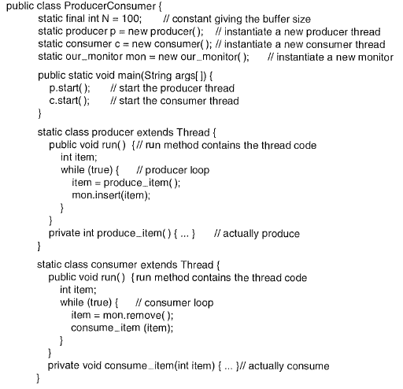
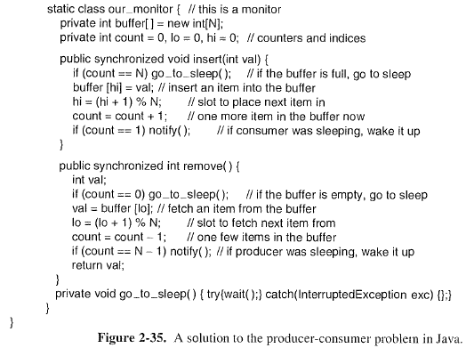
Solution to Producer-Consumer Problem in Java

Slide 98
Summary
Important concept: Atomic Operations
An operation that runs to completion or not at all
These are the primitives on which to construct various synchronization primitives
Talked about hardware atomicity primitives:
Disabling of Interrupts, test&set, swap, comp&swap, load-linked/store conditional
Showed several constructions of Locks
Must be very careful not to waste/tie up machine resources
Shouldn’t disable interrupts for long
Shouldn’t spin wait for long
Key idea: Separate lock variable, use hardware mechanisms to protect modifications of that variable
Talked about Semaphores, Monitors, and Condition Variables
Higher level synchronization constructs than locks

Slide 99
Summary Cont’
Semaphores: Like integers with restricted interface
Two operations:
P(): Wait if zero; decrement when becomes non-zero
V(): Increment and wake a sleeping task (if exists)
Can initialize value to any non-negative value
Use separate semaphore for each constraint
Monitors: A lock plus one or more condition variables
Always acquire lock before accessing shared data
Use condition variables to wait inside critical section
Three Operations: Wait(), Signal(), and Broadcast()
Readers/Writers
Readers can access database when no writers
Writers can access database when no readers
Only one thread manipulates state variables at a time
Language support for synchronization:
Java provides synchronized keyword and one condition-variable per object (with wait() and notify())

Slide 100
Quizz I
Q: Can a thread be preempted (context-switched out) within its critical section, assuming the mutex is implemented with test&set instead of interrupt disabling?
A: Yes, as long as the preempting thread is not currently in its critical section protected by the same mutex lock, i.e., they do not access conflicting shared variables.
Two threads can run concurrently on a uniprocessor with time-sharing, or in parallel on a multiprocessor, if they do not access conflicting shared variables.
No mutual
exclusion
CS1
CS2
Mutual
exclusion
Thread 1
Thread 2
Notes:
(If each thread runs on a separate processor on a multiprocessor platform, then they can run in parallel as long as

Slide 101
Quizz II
Q: Can two threads, each in its critical section, run concurrently on a uniprocessor with time-sharing, or in parallel on a multiprocessor?
A: Yes, if each thread’s critical section is protected by a different mutex lock.
In our examples so far, we have used a single mutex lock, but it is possible to have multiple mutex locks protecting different shared variables.

Slide 102
Quizz III: Implementing Semaphores w/ test&set
Q: It seems P() and V() can be interrupted/preempted while manipulating wait queue and/or ready queue. Is this a problem?
int guard = 0;
int value = 0;
P() {
// Short busy-wait time while (test&set(guard)); if (value == 0) {
put thread on wait queue;
go to sleep() & guard = 0; } else { value = value - 1; guard = 0; } }
V() { // Short busy-wait time while (test&set(guard)); if anyone on wait queue { take thread off wait queue Place on ready queue; } else { value = value + 1; } guard = 0;
}
Notes:
Note: sleep() and release the lock (set guard=0) must be atomic. Similar to the case on slide “Interrupt re-enable in going to sleep”. (can do this in software without hardware support).

Slide 103
Quizz III: Implementing Semaphores w/ test&set
A: no. A thread’s P() and V () operations must be atomic with regard to another thread’s P () and V () operations, but can be interrupted/preempted by another thread not in its P () or V () operations, hence not accessing wait queue and/or ready queue
Think of the bodies of P() and V() as (very short) critical sections protected by the mutex lock guard, although a binary semaphore itself may serve as a mutex lock to protect another application-level critical section enclosed in its P() and V() operations

